Slide 1
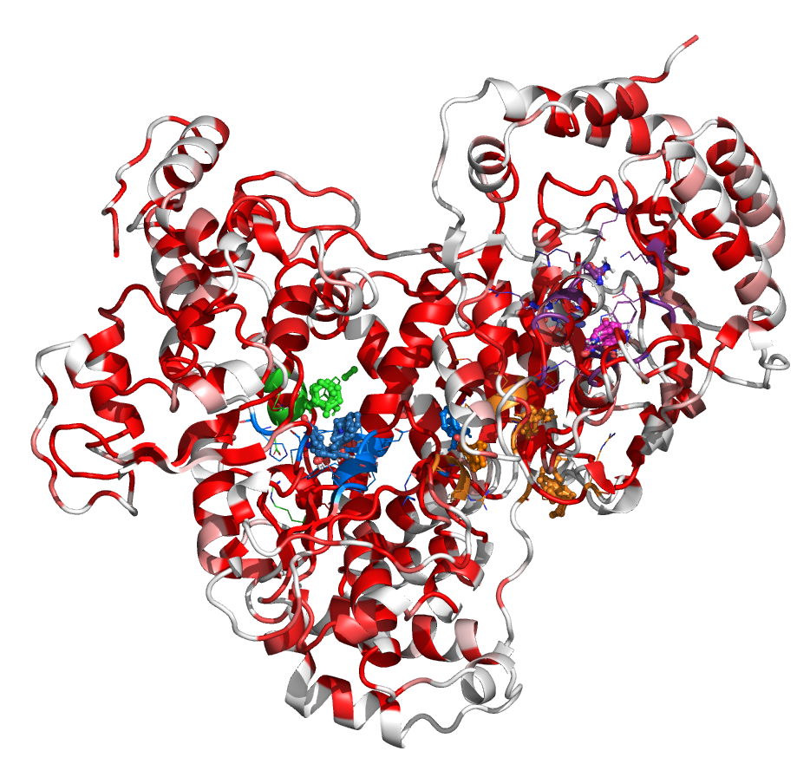
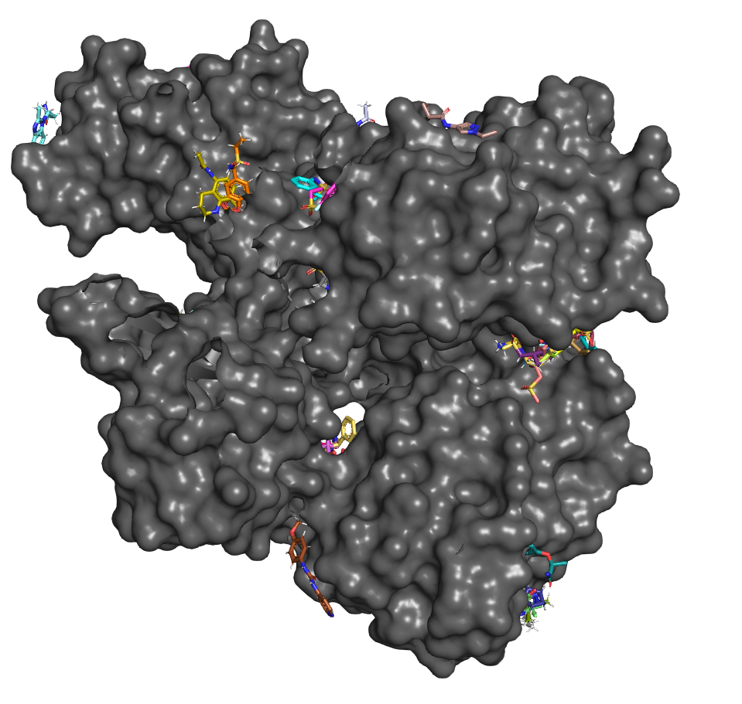
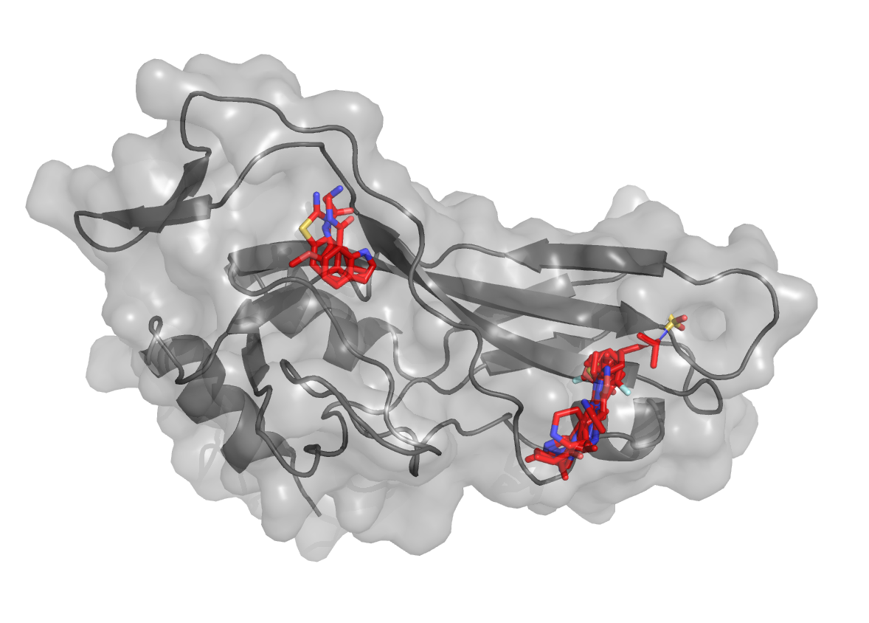
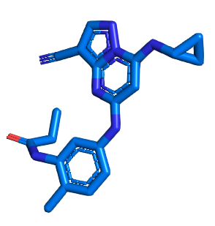
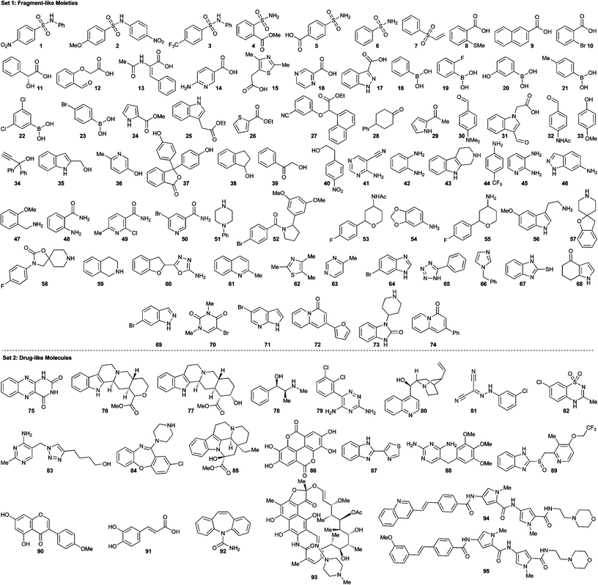
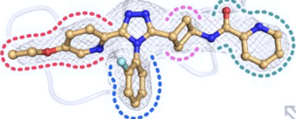
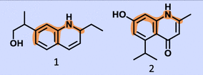

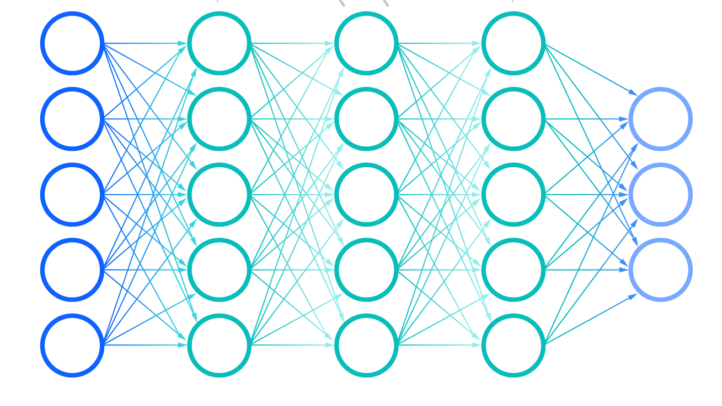

Binding sites identification and Virtual Screening protocol for DENV2 NS5
Validated site
391 395 400
| | |
RMCTREEFTRK
de novo hits
Docking
Conservation
Site identified for
Virtual Screening
Docking
Similarity
Generation
Binding site residues nomination:
~1M compounds
Conserved across viruses
Docking
Located in “druggable” cavities
Target-specific library
for initial screening
Interact with fragment/probes
Purchasable hits from
~37B Enamine REAL space
Mutations do not destabilize the protein
Validated with experimental mutagenesis
Our new AI-driven VS protocol allows to screen 37B library in 6 weeks.
We nominate 150 purchasable and 50 de novo hits for experimental testing.

